Slide 1
HNB Banking App
By: UEE_WE_46

Slide 2
Introduction
A banking app for the HNB bank.
With a focus on a more personalized experience.
Information is organized into their relevant sections.
We are presenting a better alternative to the existing app.
Did user research to see how the app is received
Used research results to identify areas that can be improved.

Slide 3
What's new?
Easy to navigate through the interfaces.
Replaced web app with native android app.
Better organizing of information.
Better overall user experience.

Slide 4
Marketing Opportunities
Did an anonymous survey of 5 people and got their feedback.
Made a flyer that can be handed out in bank branches
Did a user testing video
Researched applications from competitors.

Slide 5
Survey Results
Most users were satisfied the quality of the interface (avg:4.2)
Most users were happy with the navigation, (avg: 4.0)
Some users thought the app was not informative enough.
Users had some difficulty in accomplishing tasks quickly (avg: 3.6)
Users preferred the app to offline banking (avg:4.6)
Overall experience of the app was excellent (avg: 4.8)
Users would recommend the app to others (avg: 4.8)

Slide 6
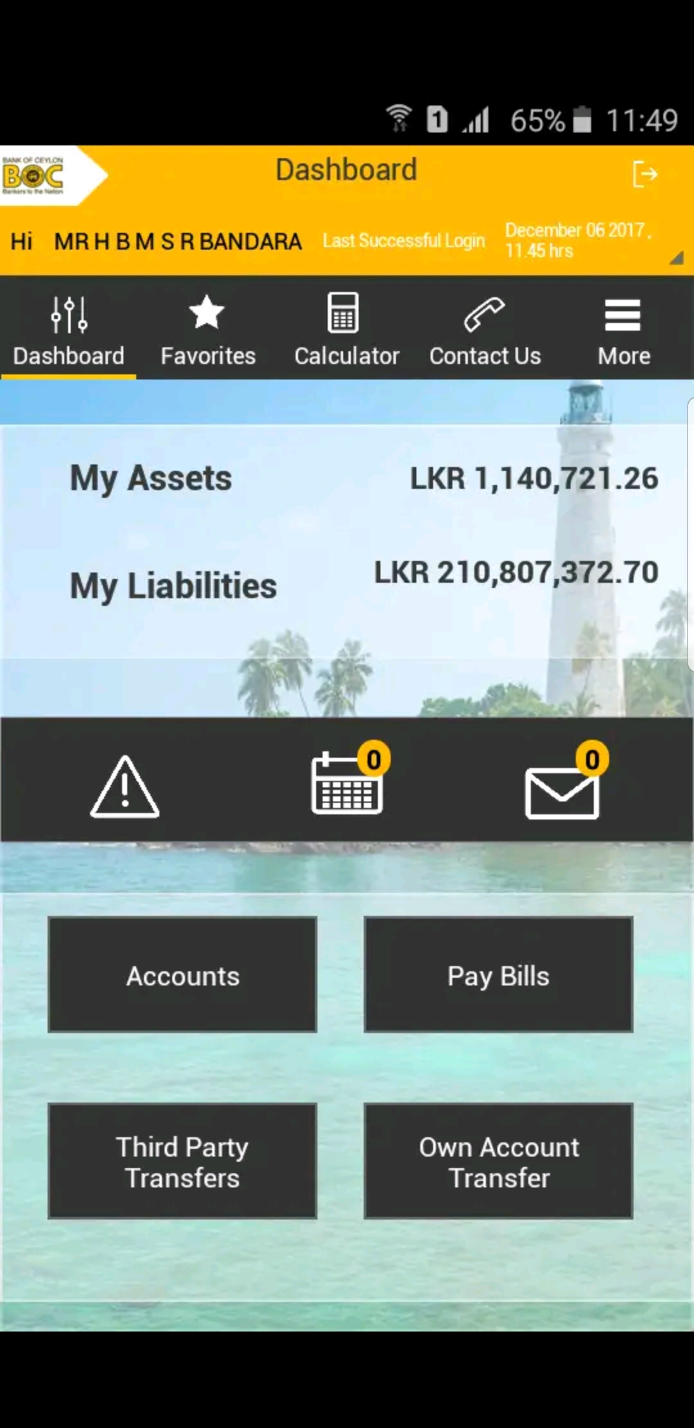
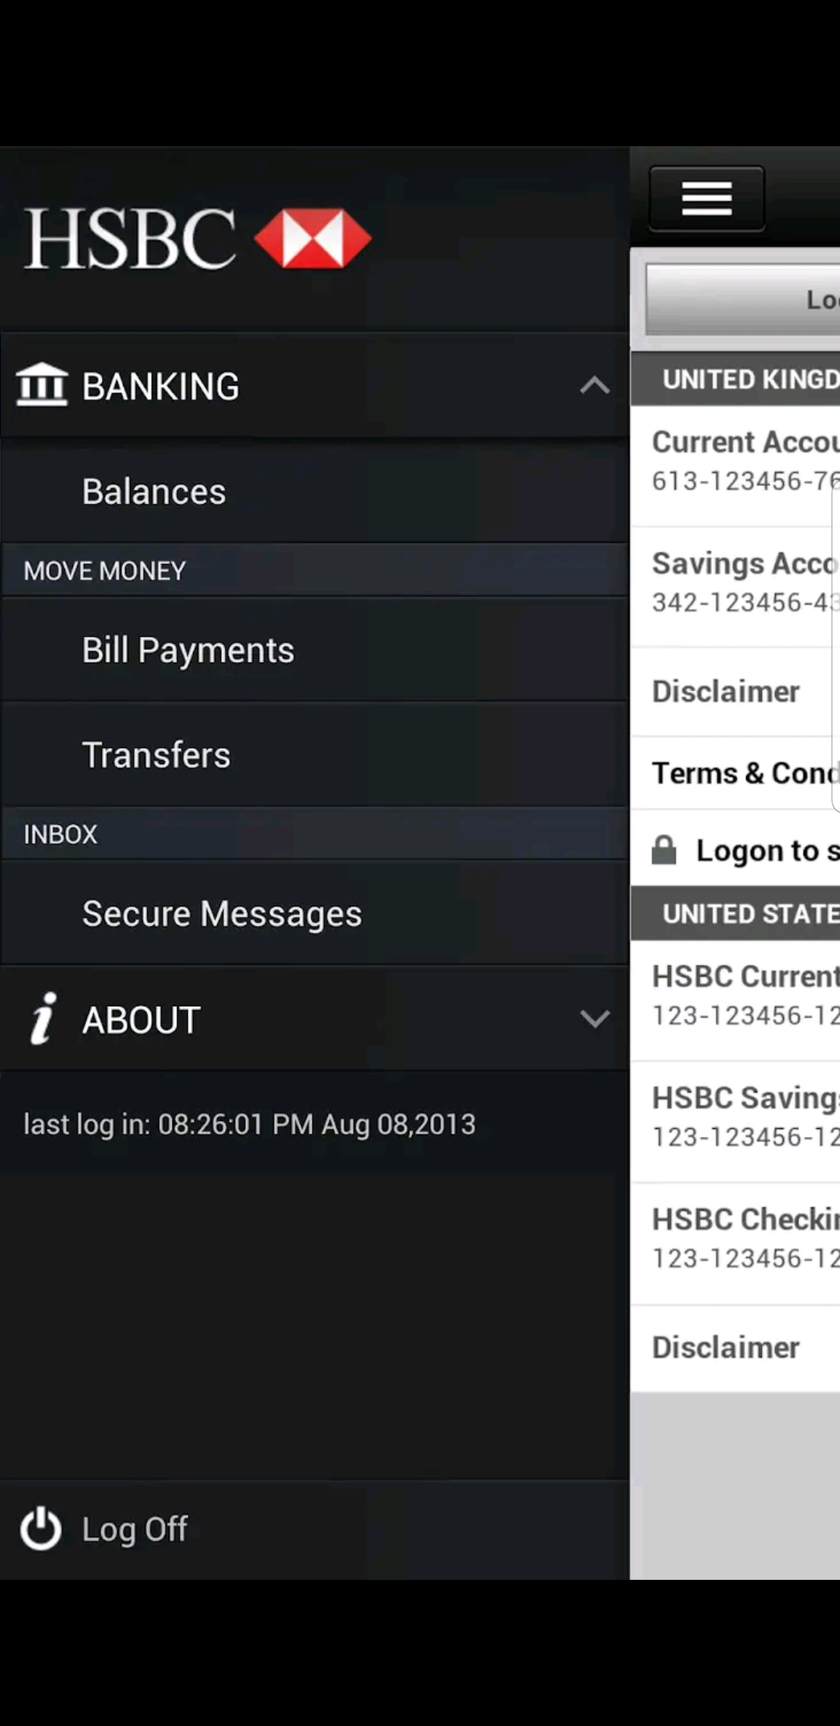
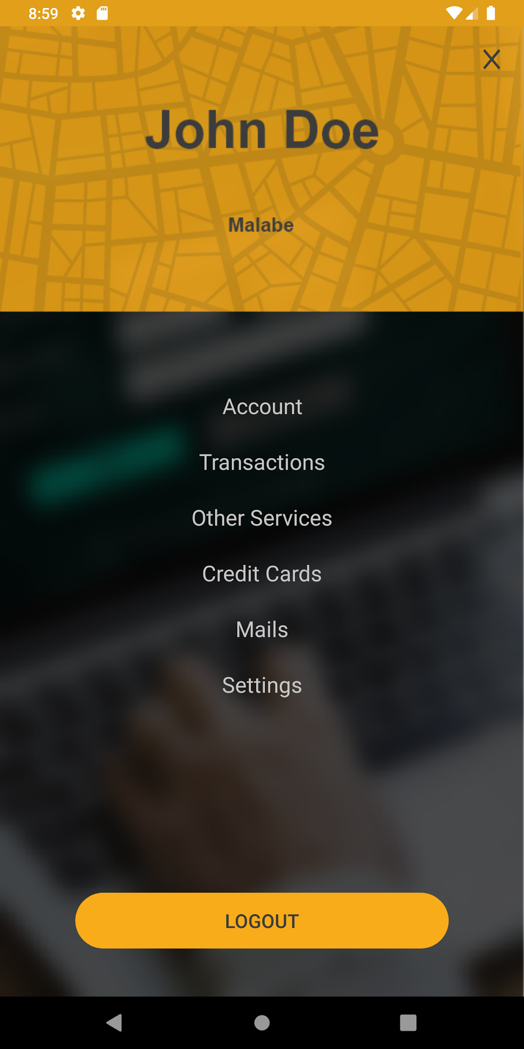
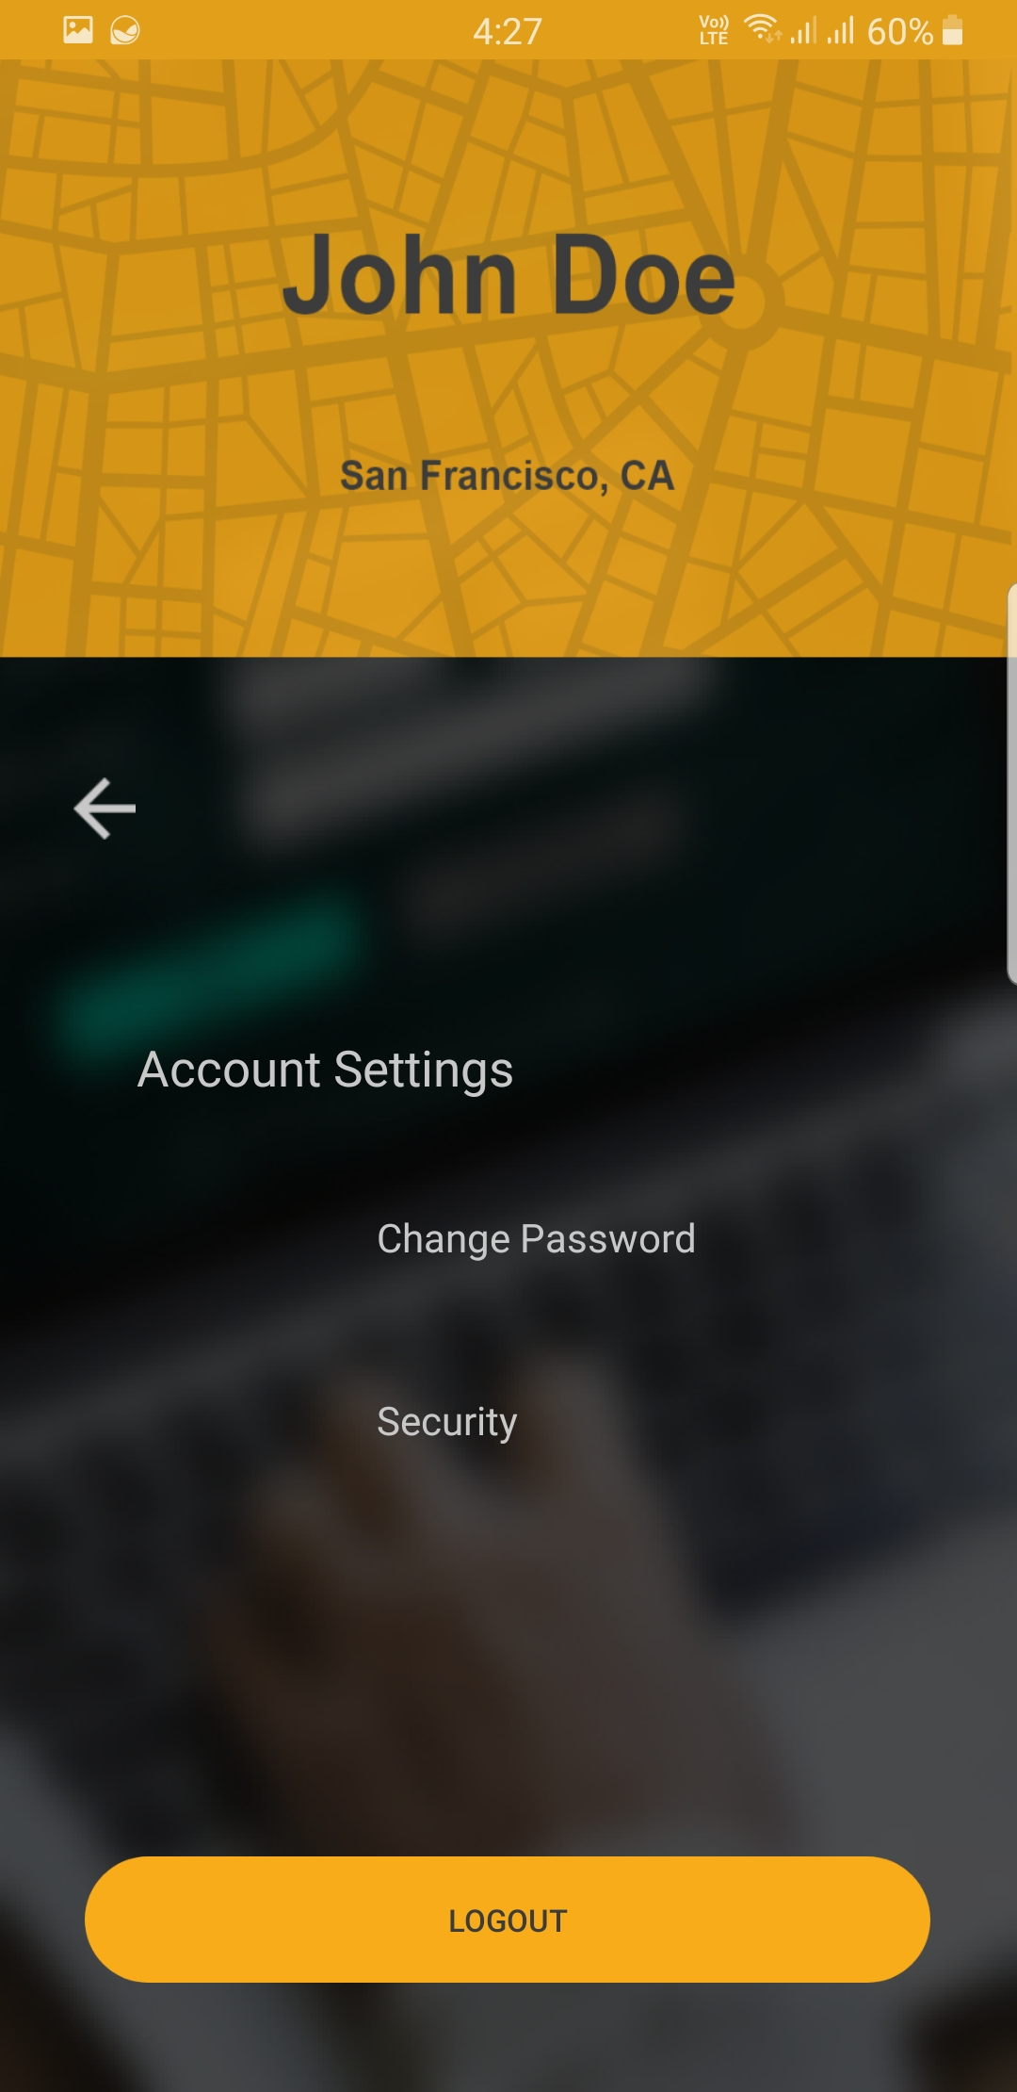
Compared to other products
Easier to navigate through the interfaces.
All the account details are accessible through a single interface.

Slide 7
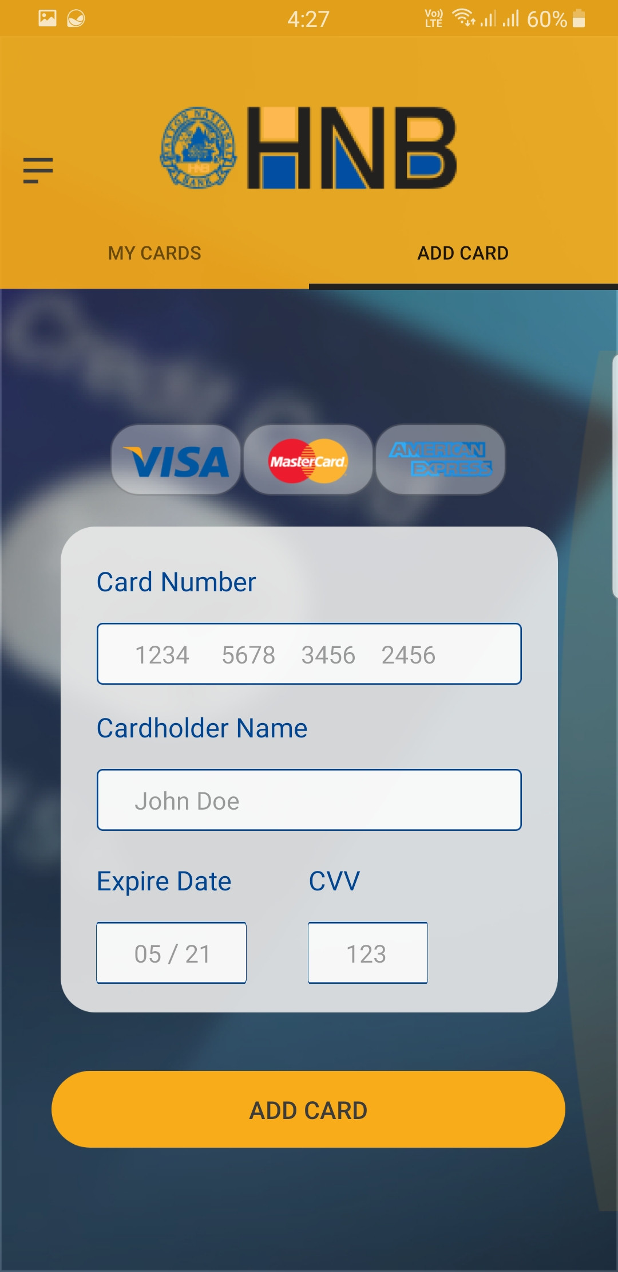
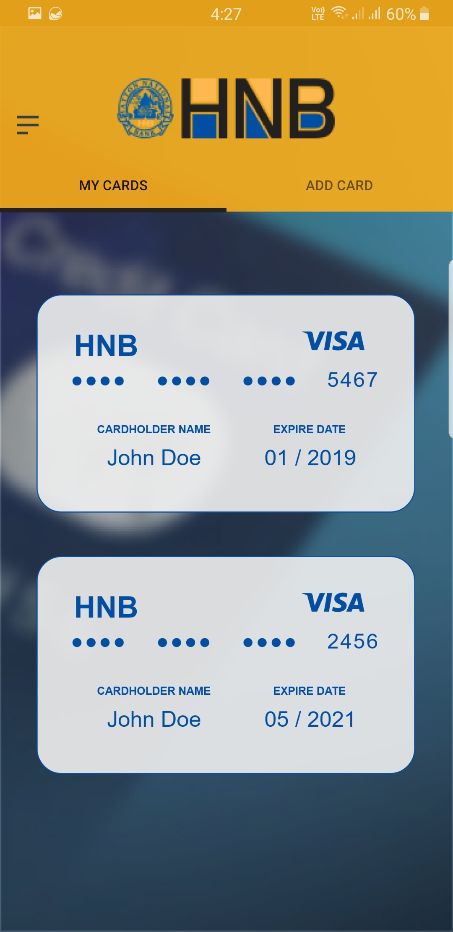
Compared to other products
Most competitors use a web app instead of using a native app.
Most applications show all the informations in single user interface.
Credit card details are displayed in a user friendly manner.
Sub Interfaces are divided into tabs for easier navigation.

Slide 8
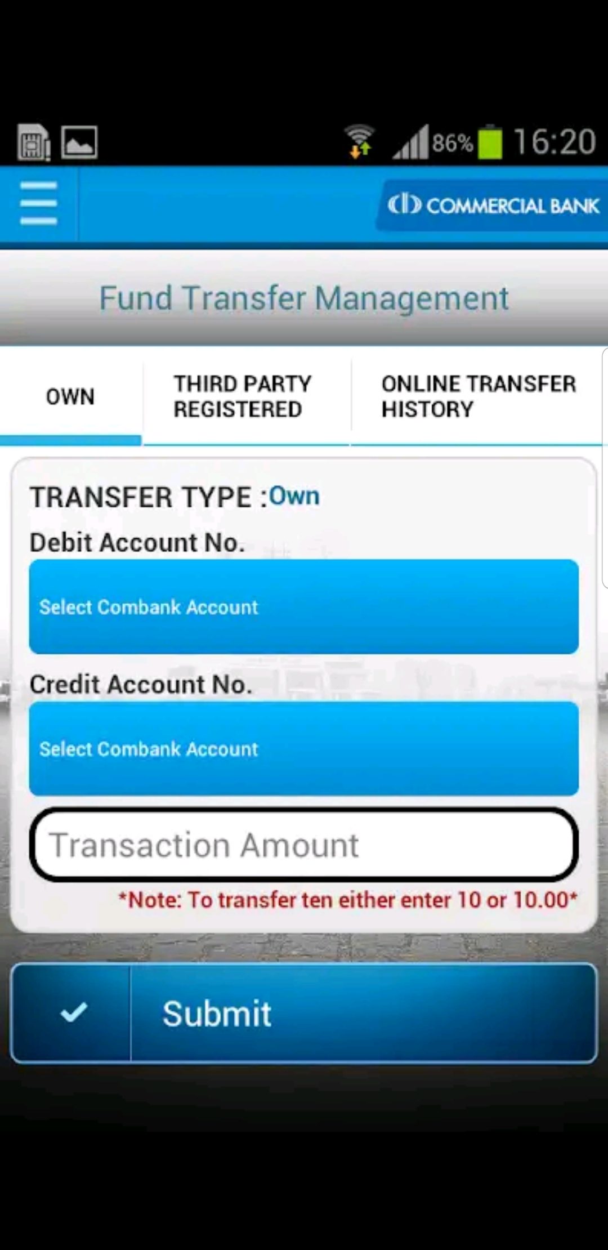
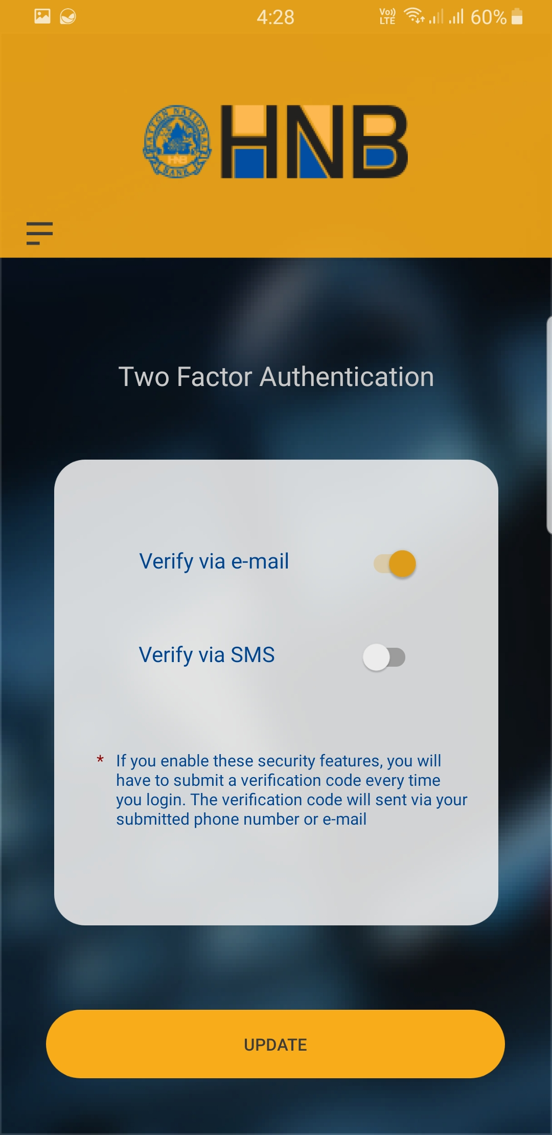
Compared to other products
The text is not legible due to color.
Easier to change options with just a single tap.

Slide 9
EXISTING vs IMPROVED

Slide 10
CREDIT CARDS

Slide 11
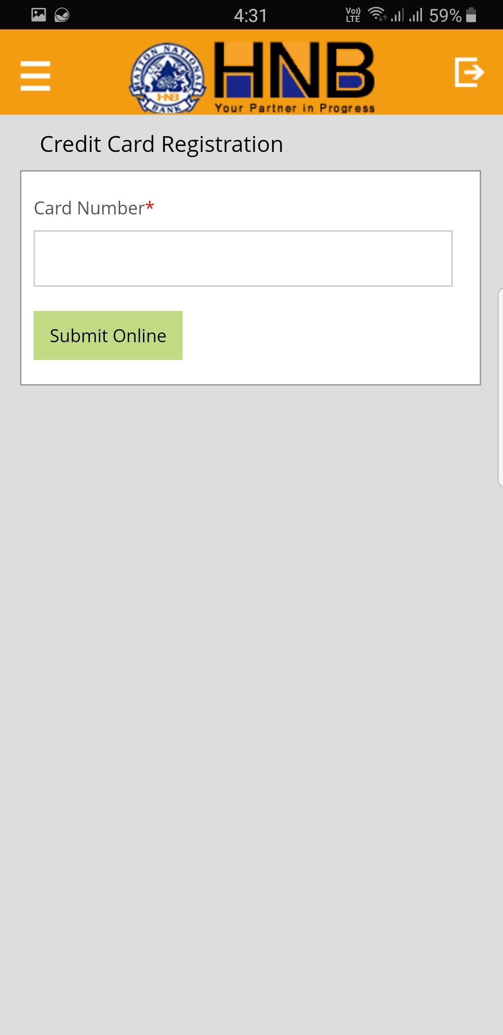
Credit Card Registration
Faults in existing app :-
Not secure as anyone with the credit card number can add a card
Our improved solution :-
Request other details like the cardholder name and CVV number before registering card.

Slide 12
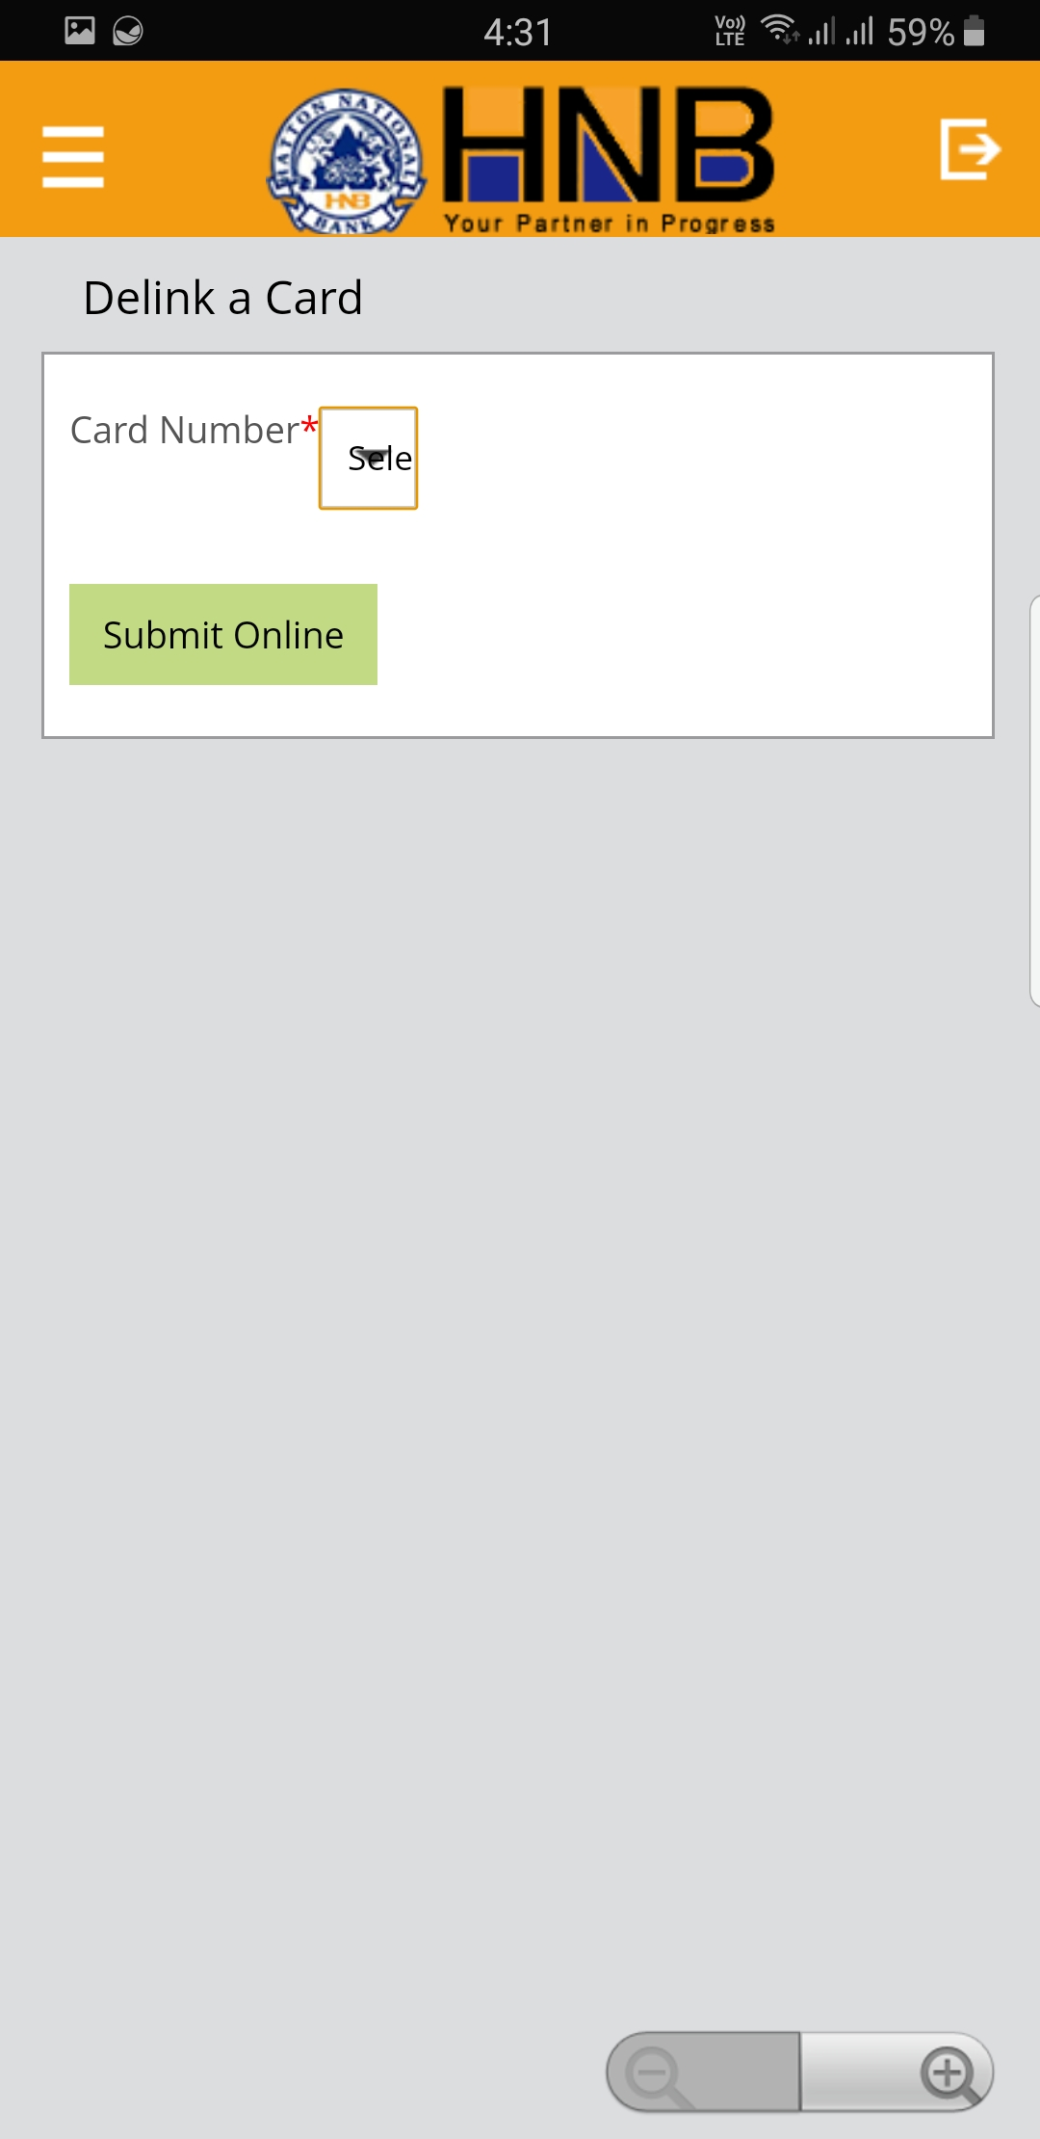
Credit Card Delink
Faults in existing app :-
The card number is not displayed properly which may result in delinking of wrong card.
Our improved solution :-
Each linked card is displayed properly with all details, which makes identification easier.

Slide 13
TRANSACTIONS

Slide 14
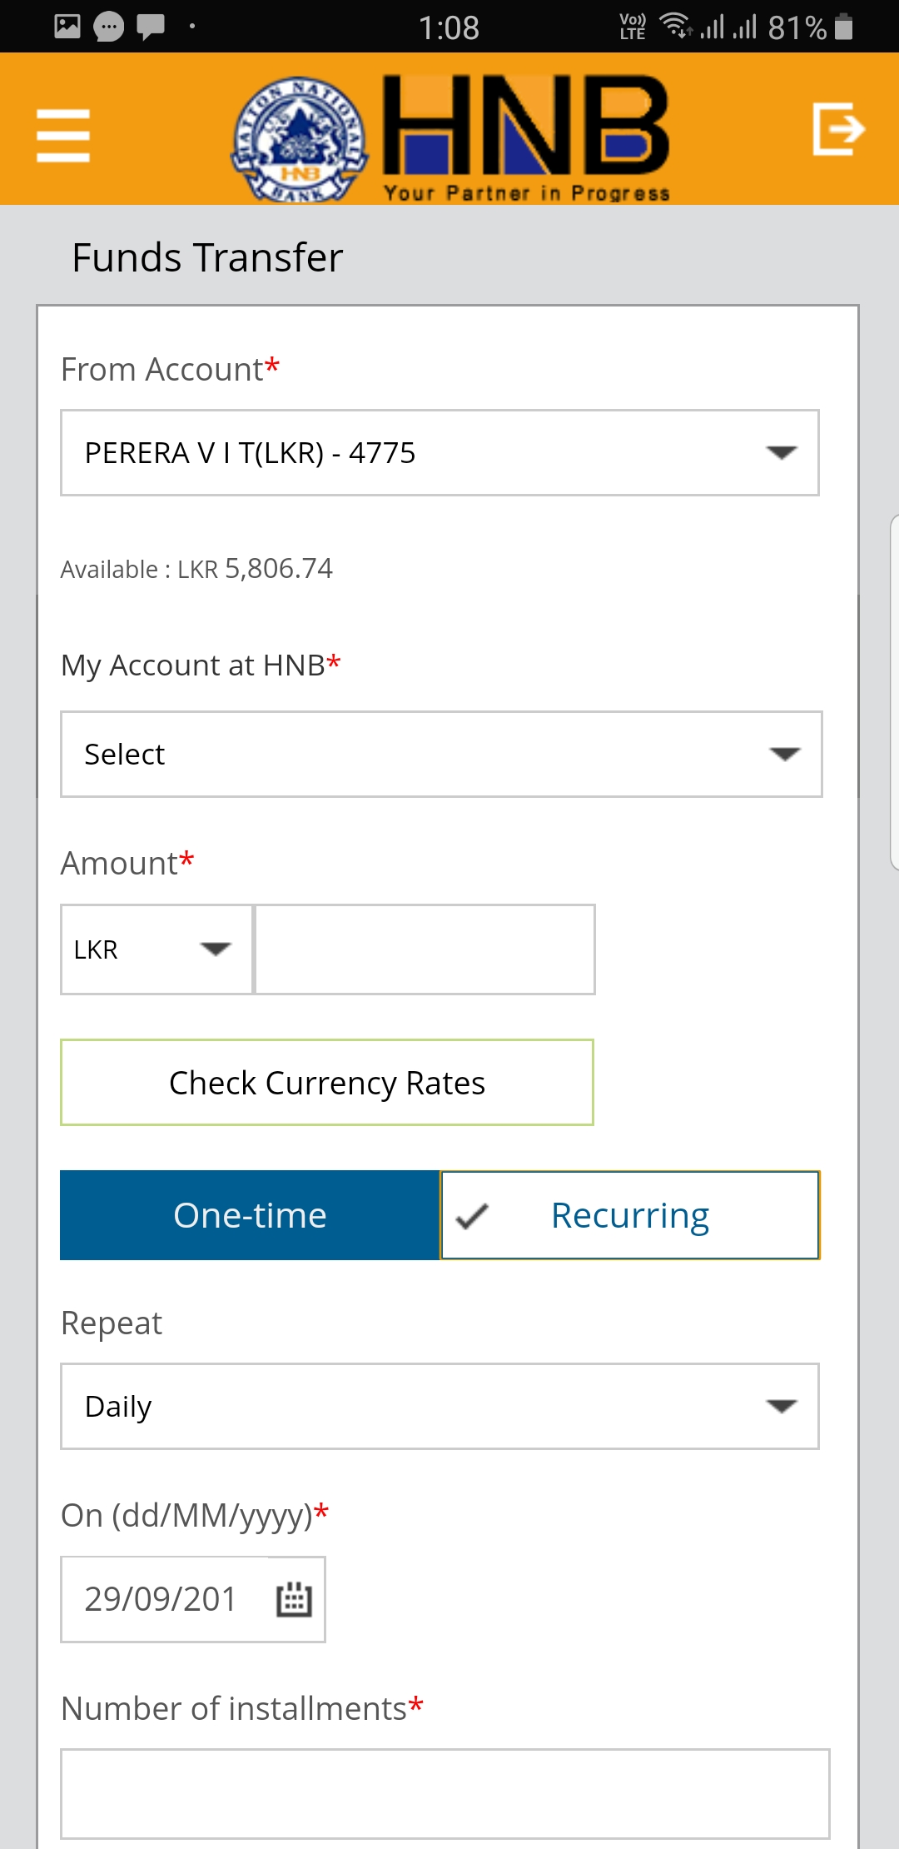
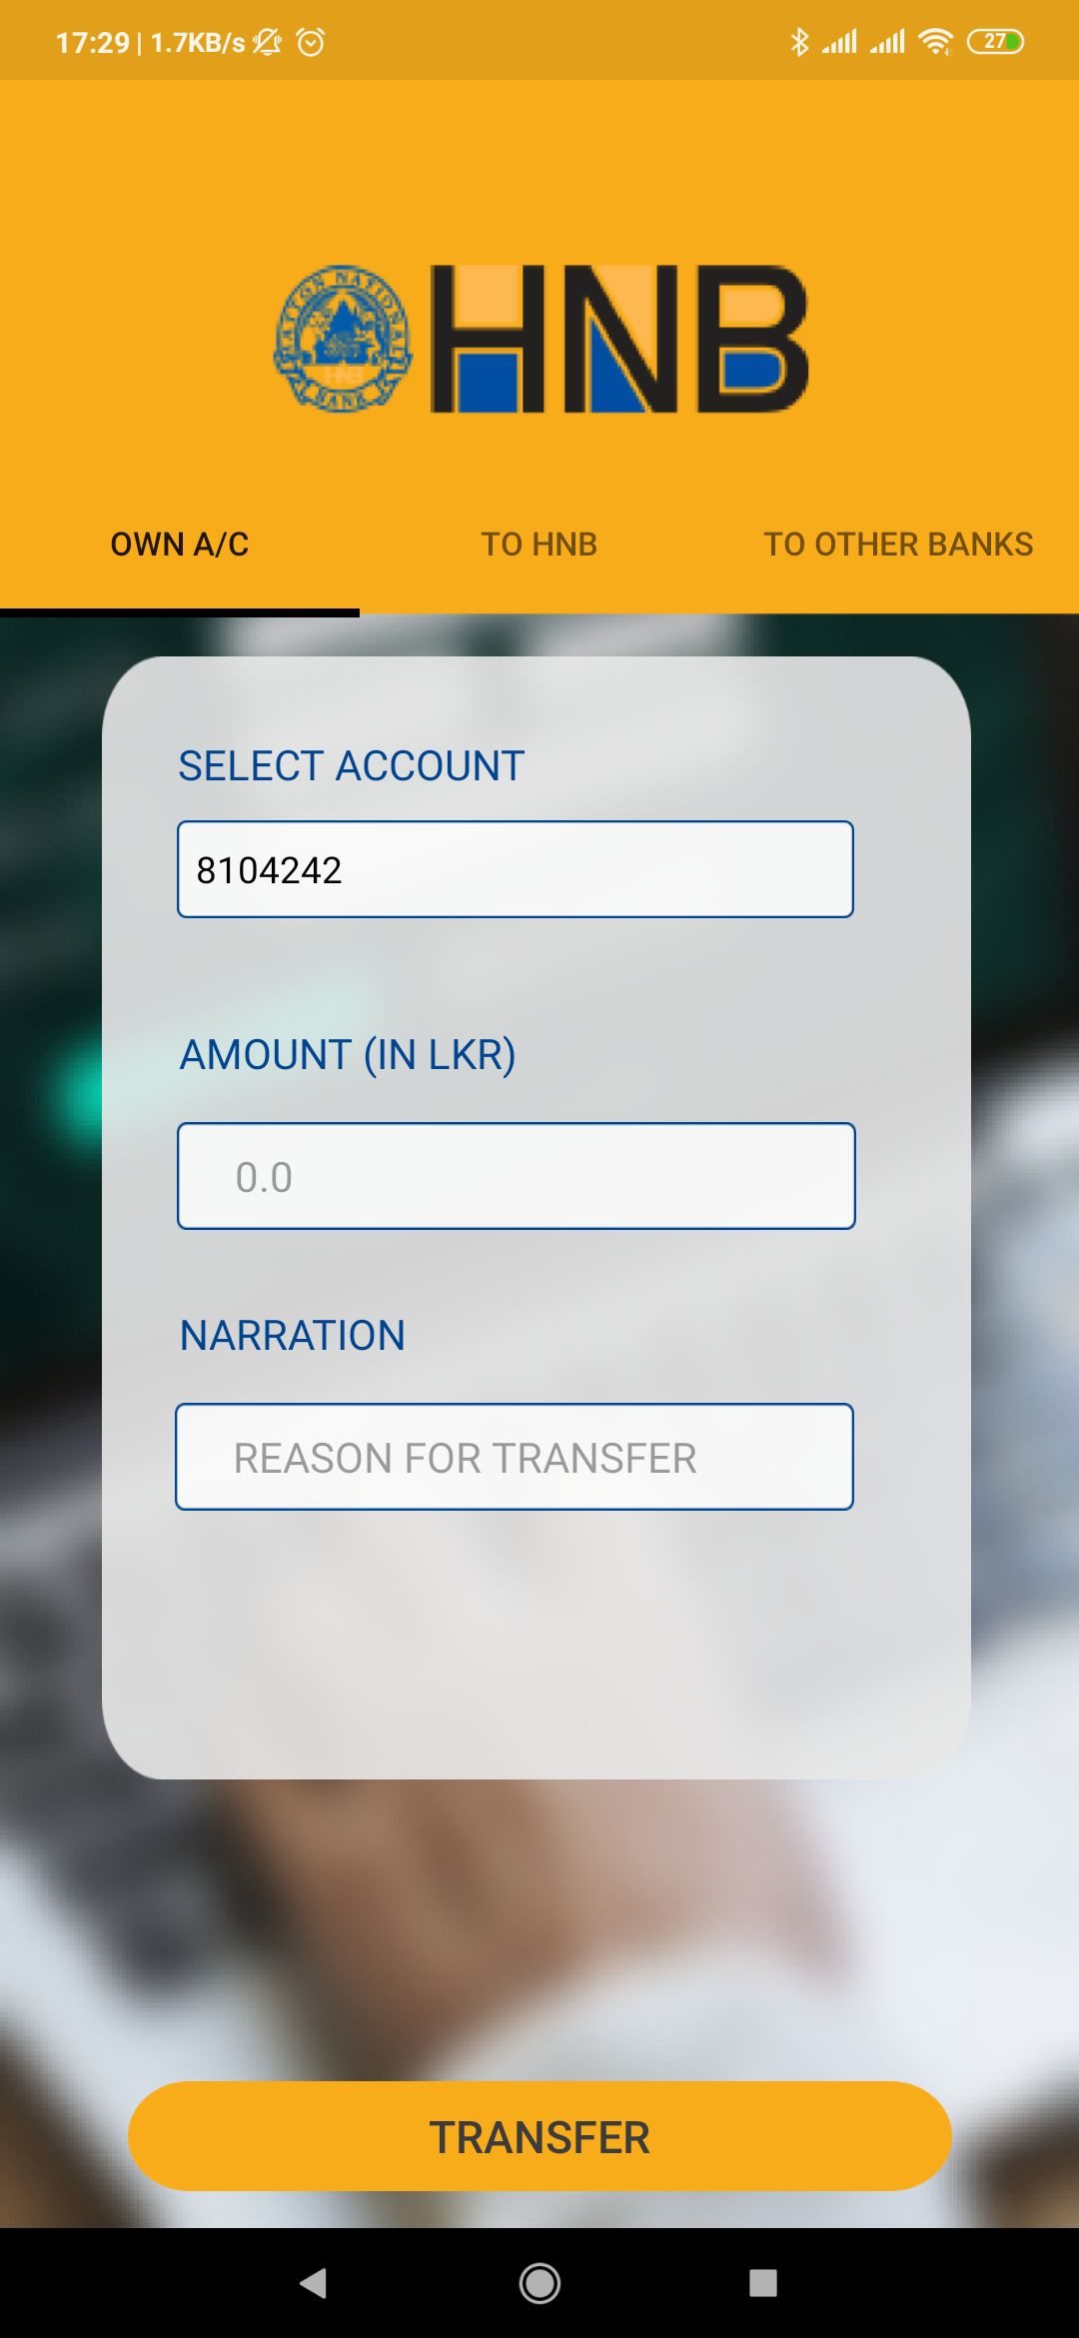
Bank Transfers
Faults in existing app :-
The UI doesn’t mention what type of transfer is being made. Switching between different types requires going to the menu.
Our improved solution :-
All three types of transfers are under one menu item and can be switched between easily with a swipe.

Slide 15
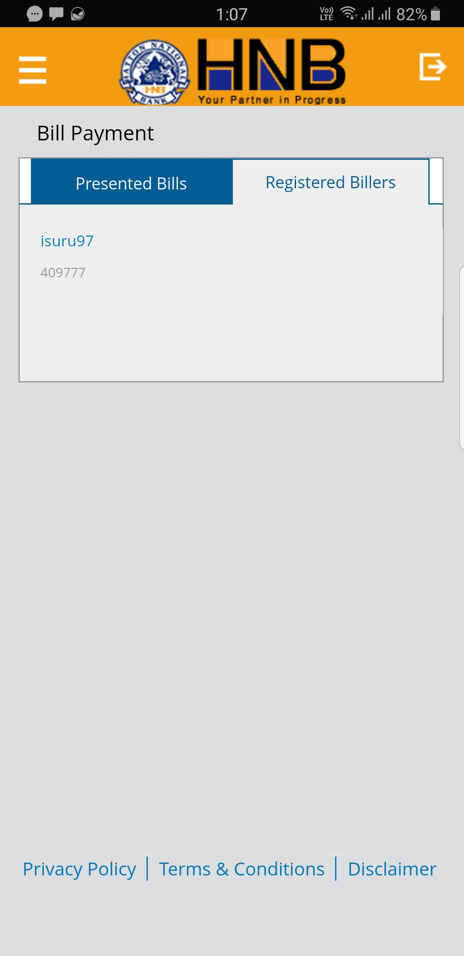
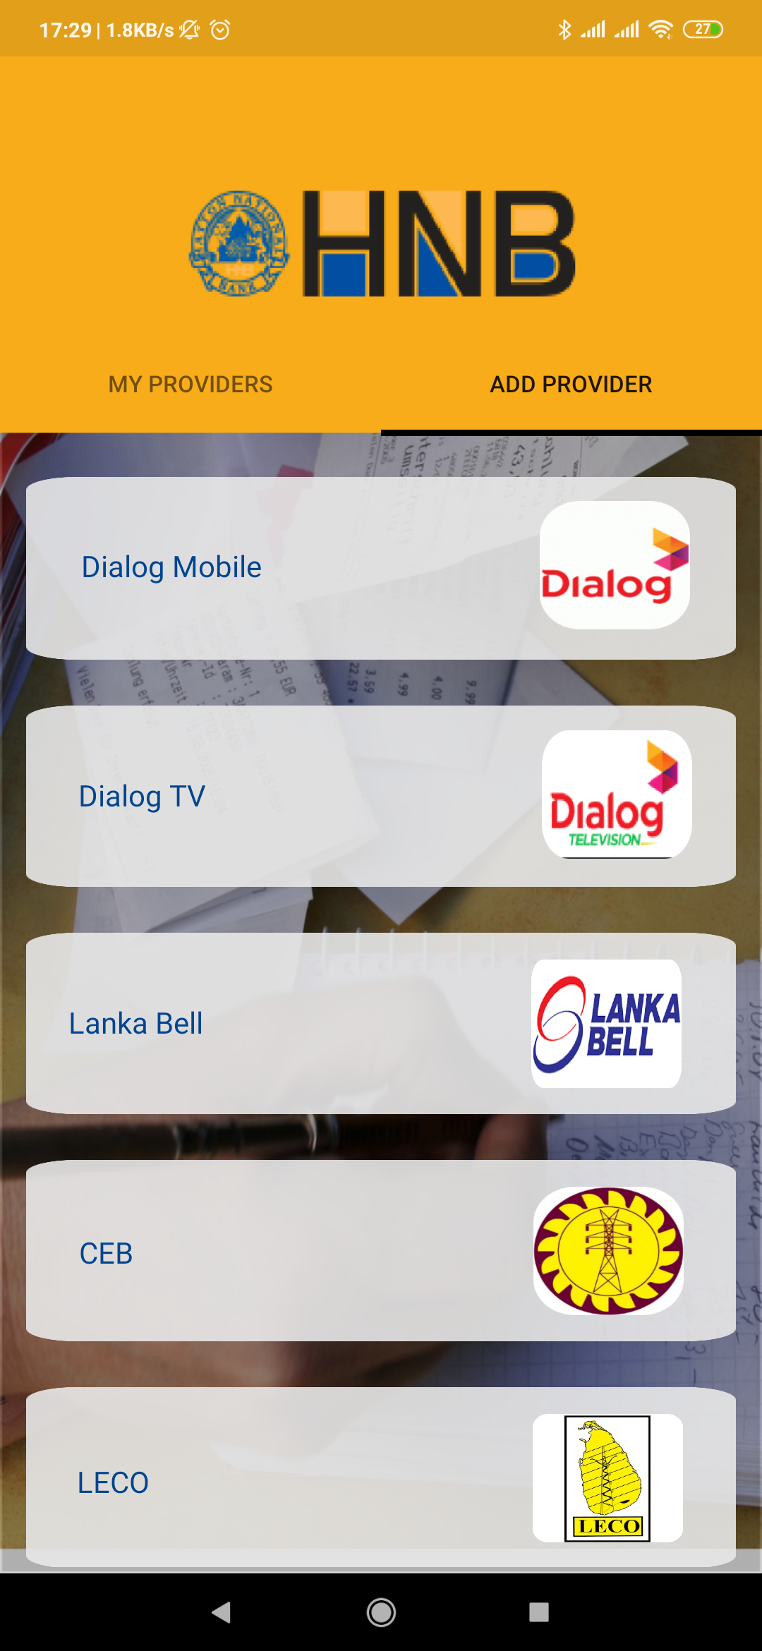
Bill Payments
Faults in existing app :-
The UI is confusing and cluttered. Providers need to be registered on a PC before a payment is made
Our improved solution :-
A simple UI displays all registered providers and they can be registered in-app.

Slide 16
Future Improvements
Speed of the app will be improved in the coming versions.
Add support for online wallets like paypal and google pay.
Add support for more bill payments.
Planned IOS release.

